Slide 1
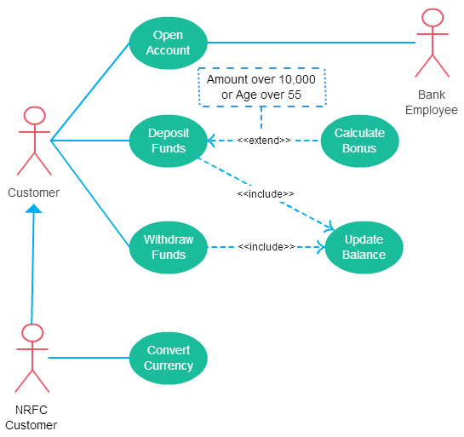
Banking system- use case diagram

Slide 2
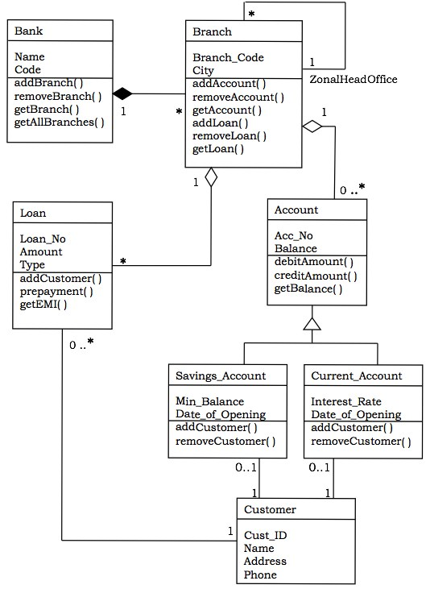
Banking system- class diagram

Slide 3
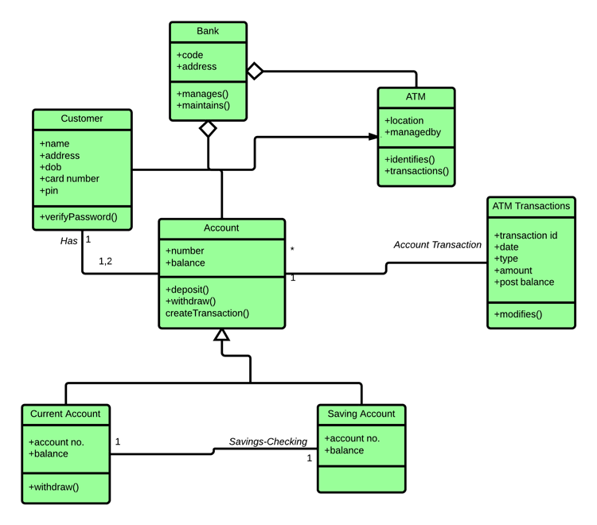
Banking system- class diagram

